Slide 1
New VGAE model
New VGAE model: Flawless1202/VGAE_pyG: An VGAE implementation using pytorch geometric. (github.com)
Input: 30 graphs with 10 nodes
Optimizers: Adams optimizer with learning rate 0.001
Epoches: 1000000 epoches
Latent space: 2 out-channels

Slide 2
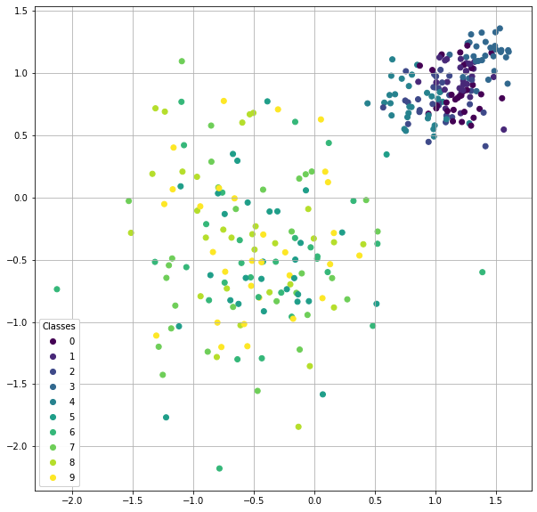
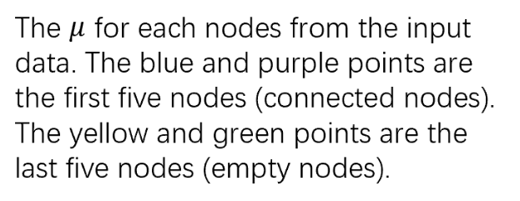

Slide 3
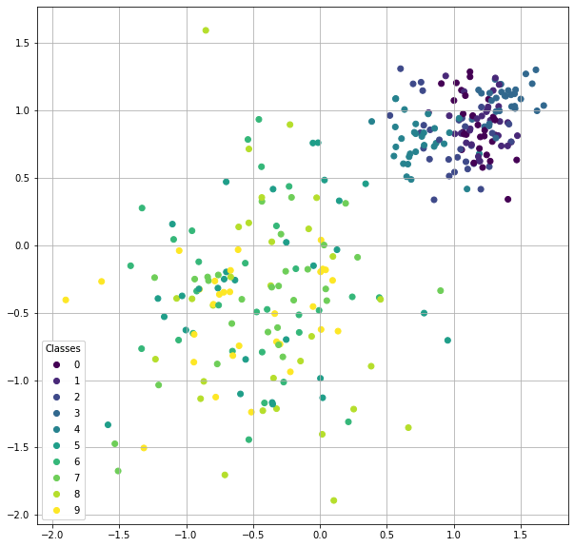
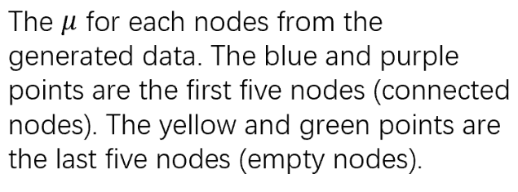

Slide 4
input
generated

Slide 5
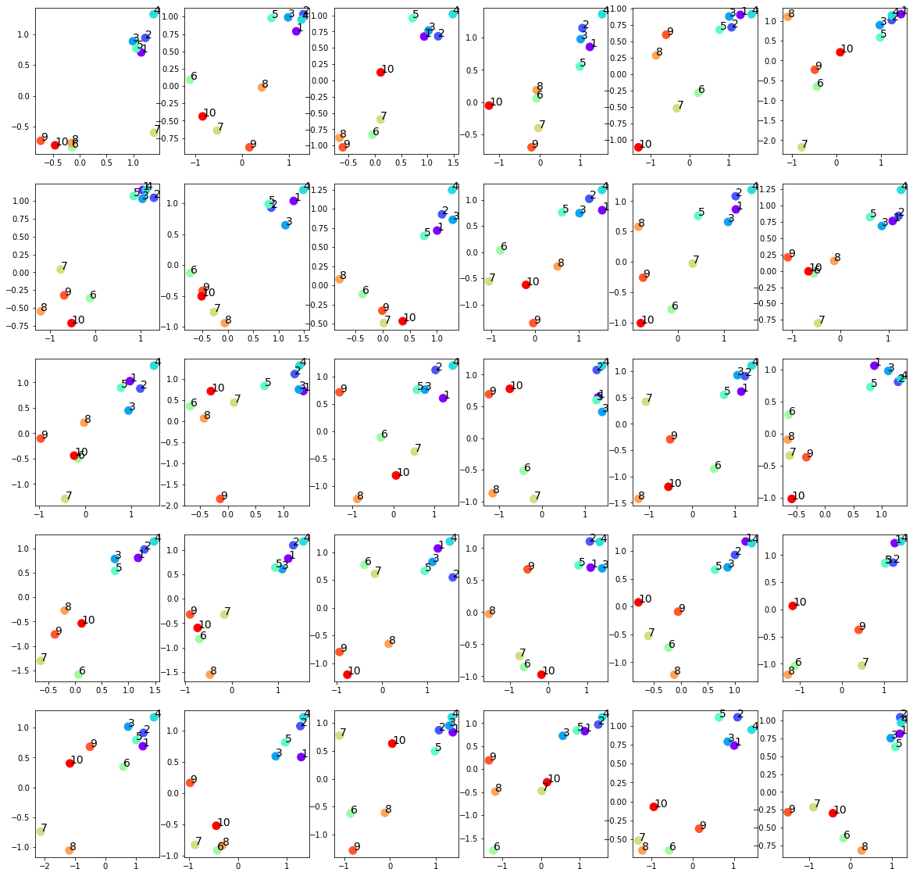
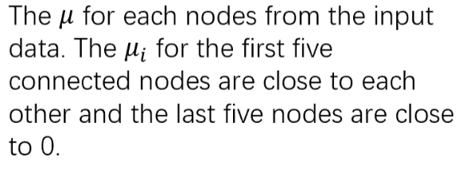

Slide 6
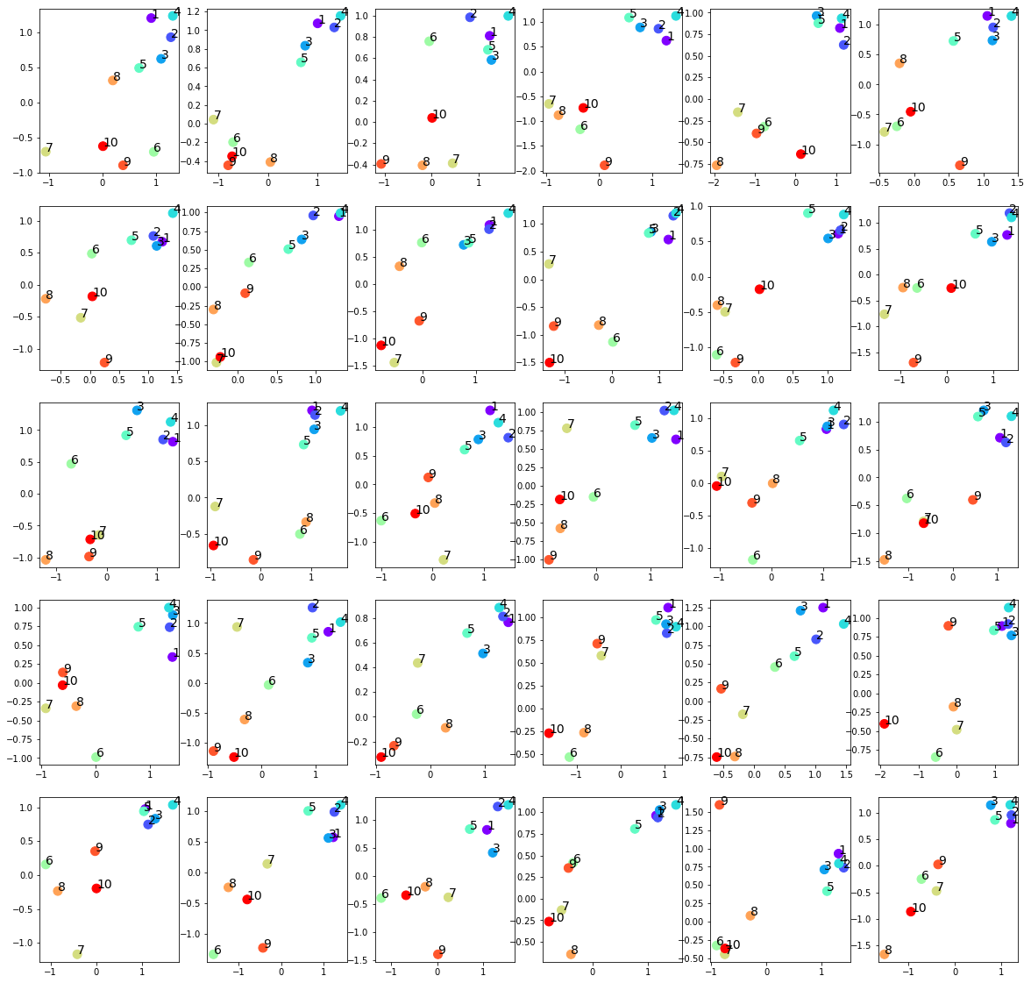
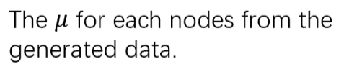

Slide 7
input
generated

Slide 8
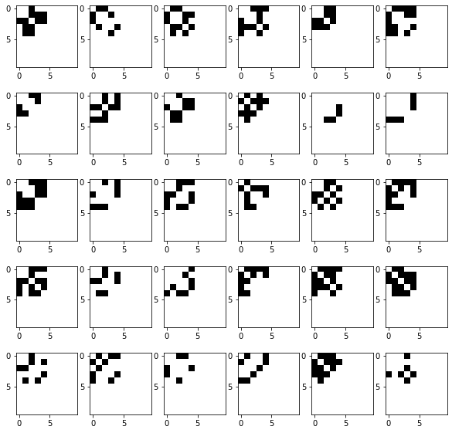
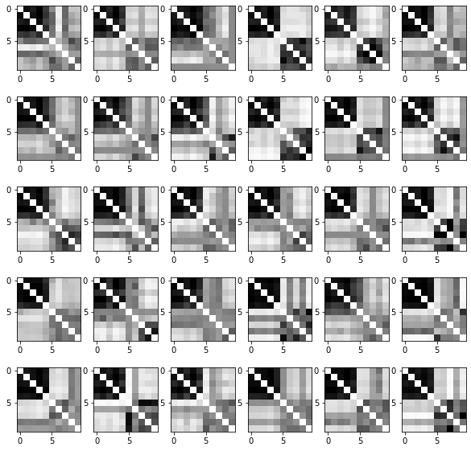
Input adjacency matrices (p=0.5)
Raw generated adjacency matrices (filter_value=0)

Slide 9
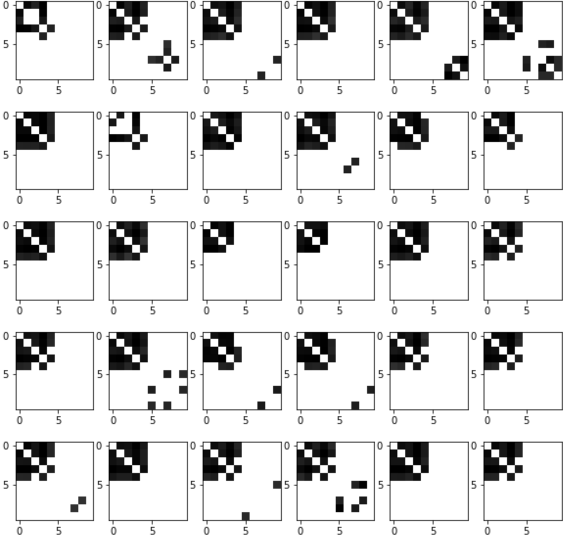
Input adjacency matrices (p=0.5)
generated adjacency matrices (filter_value=0.5)

Slide 10
Normalized Centrality
Node index | 1 | 2 | 3 | 4 | 5 | 6 | 7 | 8 | 9 | 10
Generated matrices centrality | 0.33 | 0.34 | 0.30 | 0.36 | 0.26 | 0.02 | 0.01 | 0.03 | 0.01 | 0.02
Original matrices centrality | 0.19 | 0.19 | 0.17 | 0.20 | 0.22 | 0. | 0. | 0. | 0. | 0.

Slide 11
New VGAE model
New VGAE model: Flawless1202/VGAE_pyG: An VGAE implementation using pytorch geometric. (github.com)
Input: 30 graphs with 10 nodes
Optimizers: Adams optimizer with learning rate 0.001
Epoches: 1000000 epoches
Latent space: 2 out-channels
p = 0.8 for the upper left submatrix

Slide 12
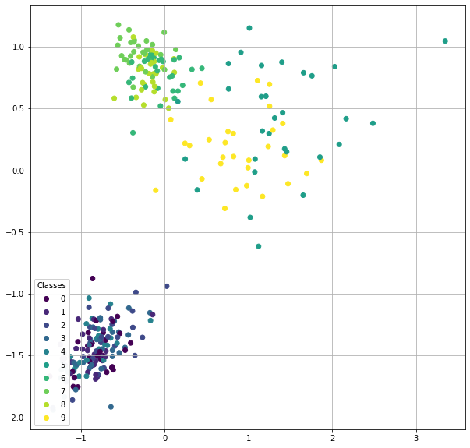

Slide 13
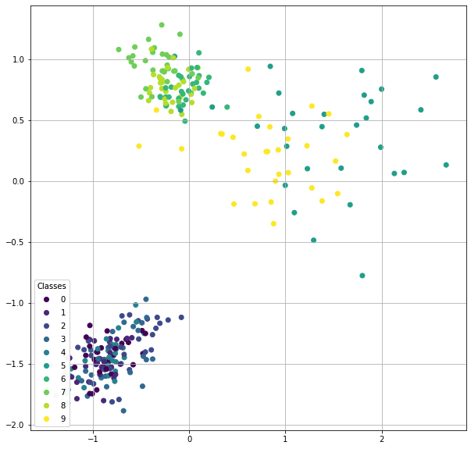

Slide 14
input
generated

Slide 15
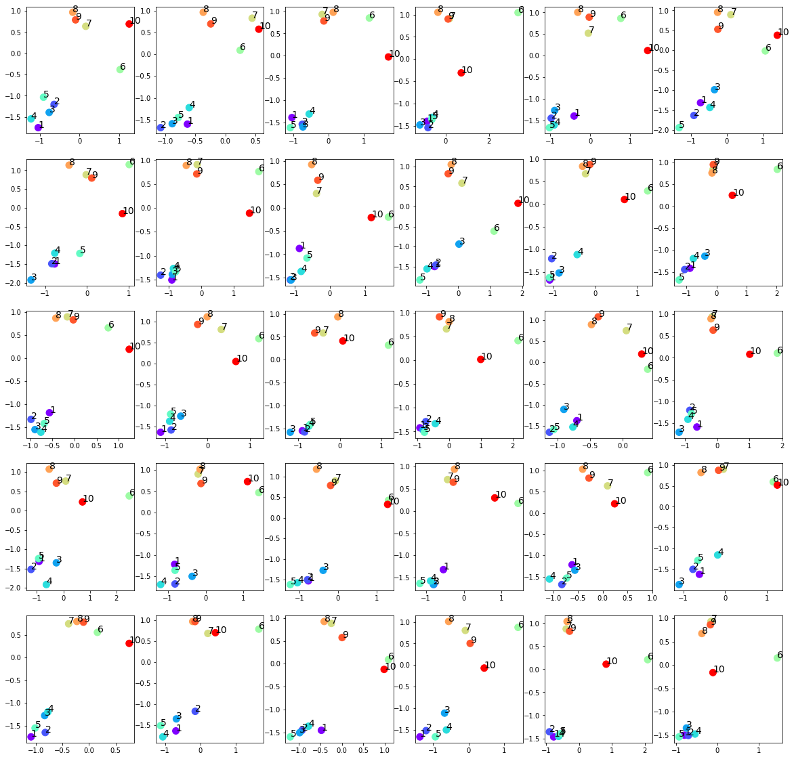

Slide 16
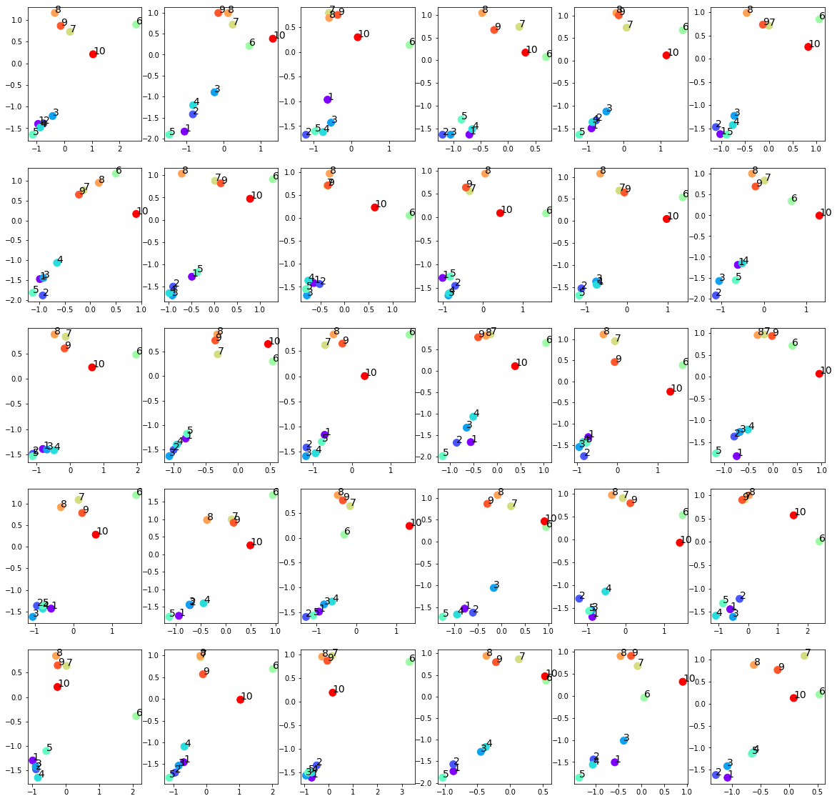

Slide 17
input
generated

Slide 18
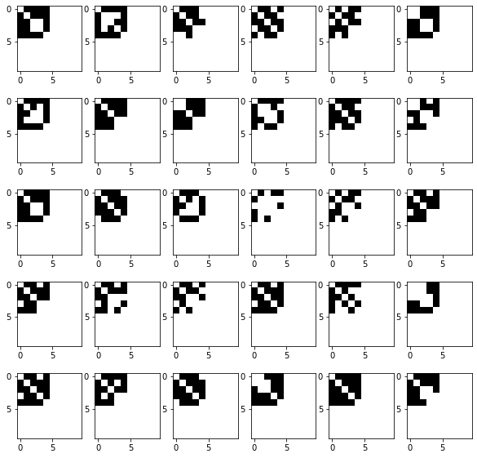
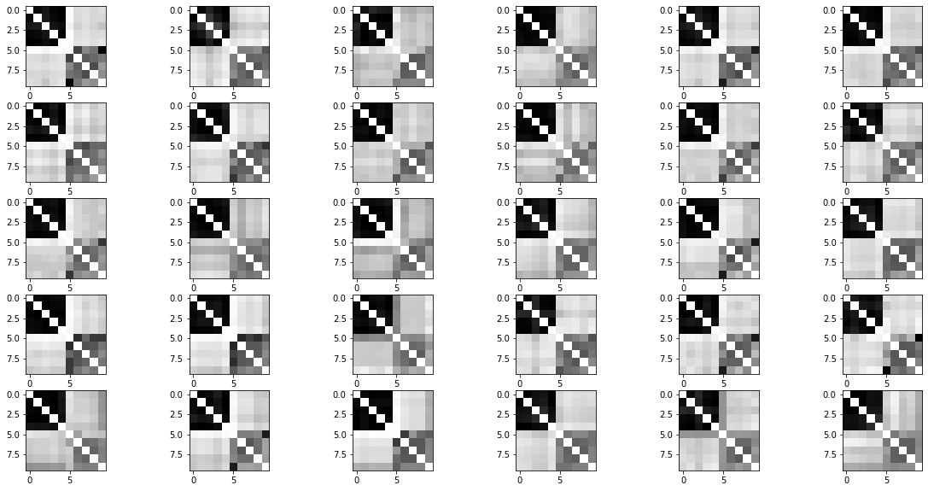
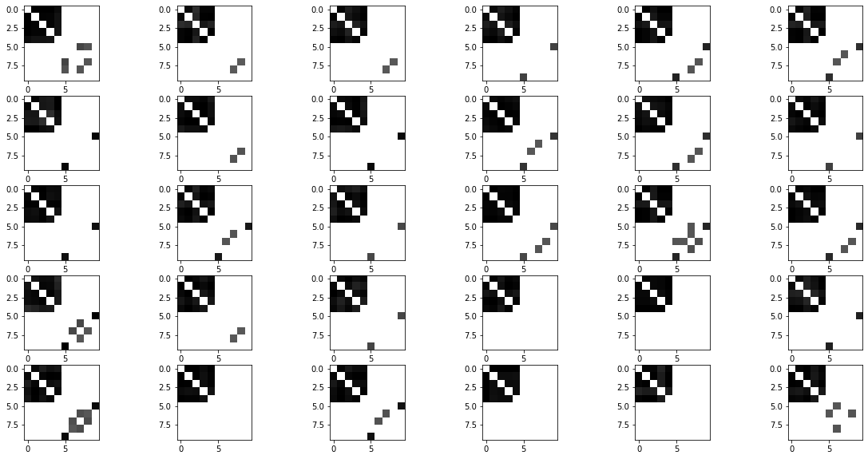
Raw generated adjacency matrices (filter_value=0)
Input adjacency matrices (p=0.8)
Generated adjacency matrices (filter_value=0.5)

Slide 19
Normalized Centrality
Node index | 1 | 2 | 3 | 4 | 5 | 6 | 7 | 8 | 9 | 10
Generated matrices centrality | 0.37 | 0.34 | 0.36 | 0.37 | 0.37 | 0.06 | 0.02 | 0.05 | 0.03 | 0.05
Original matrices centrality | 0.32 | 0.34 | 0.30 | 0.32 | 0.31 | 0. | 0. | 0. | 0. | 0.

Slide 20
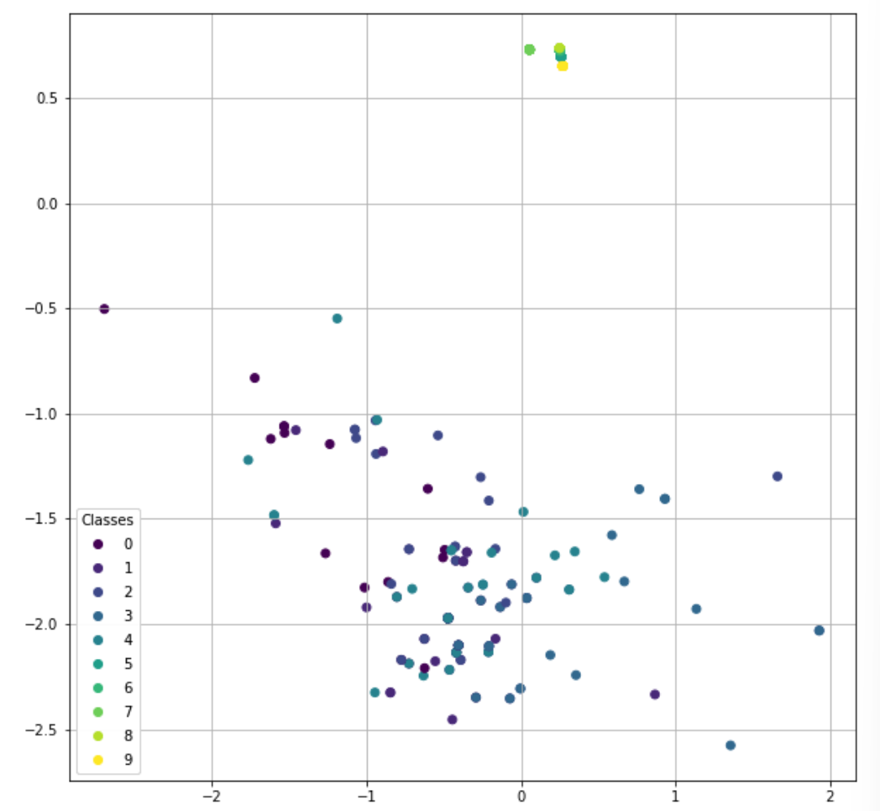
Another pattern:
The last five nodes over-concentrate around 0
No effect on the first five nodes
Easier to happen when setting lower learning rate

Slide 21
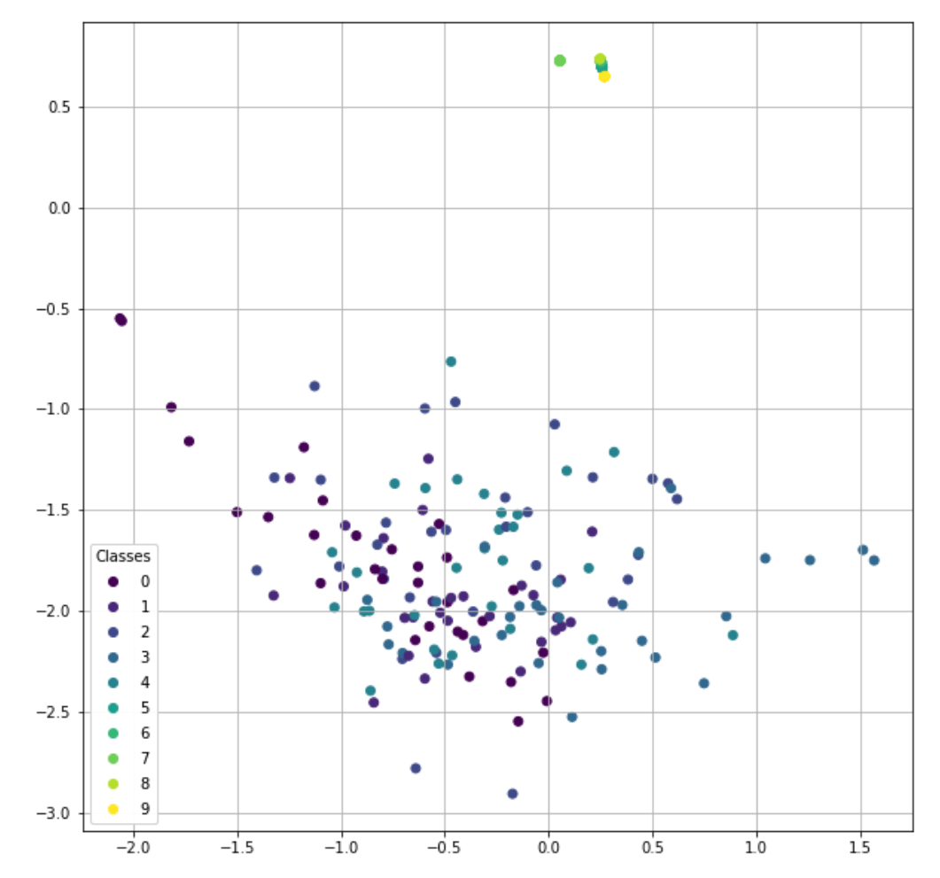

Slide 22
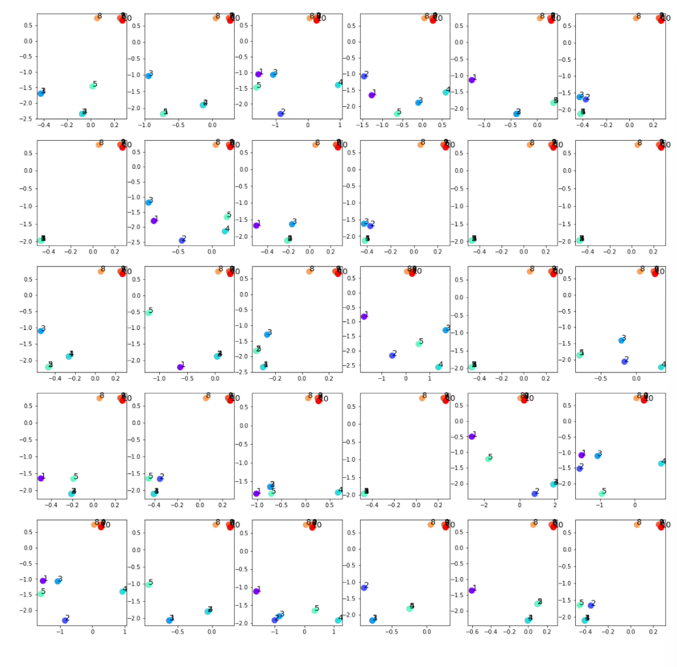

Slide 23
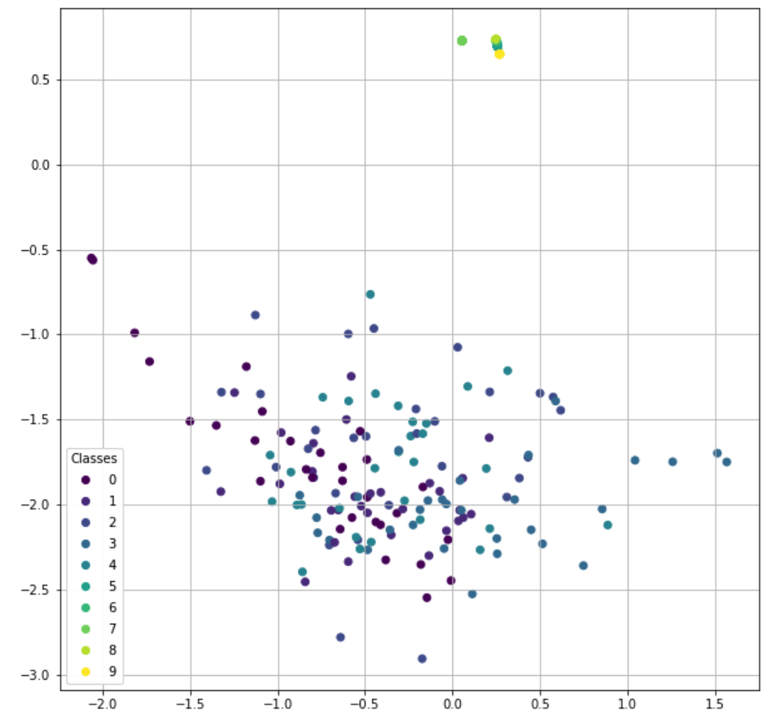

Slide 24
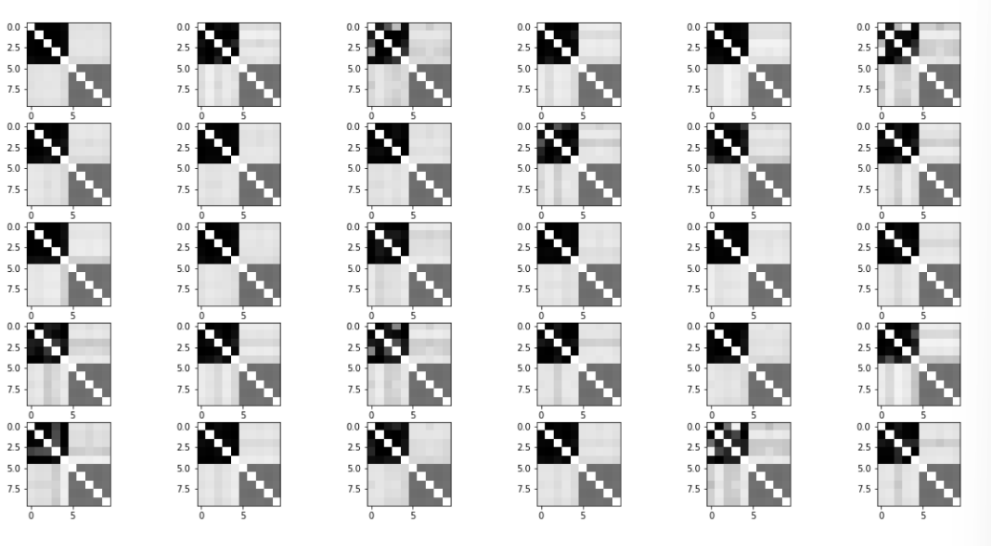
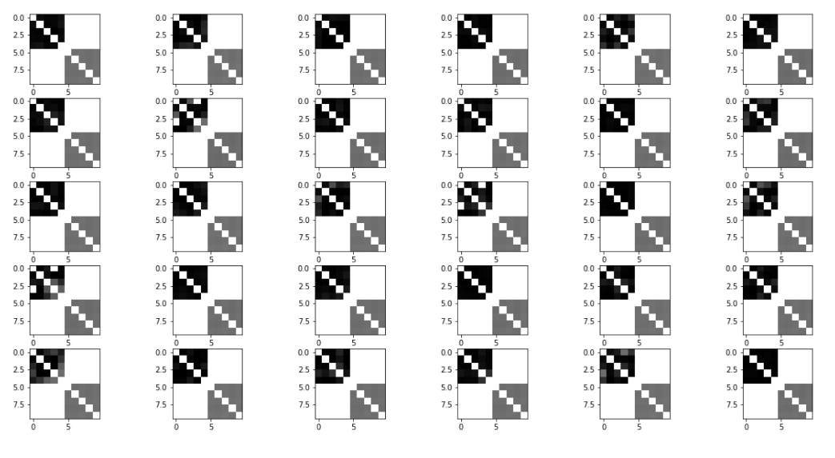
Raw generated adjacency matrices (filter_value=0)
Input adjacency matrices (p=0.8)
Generated adjacency matrices (filter_value=0.5)

Slide 25
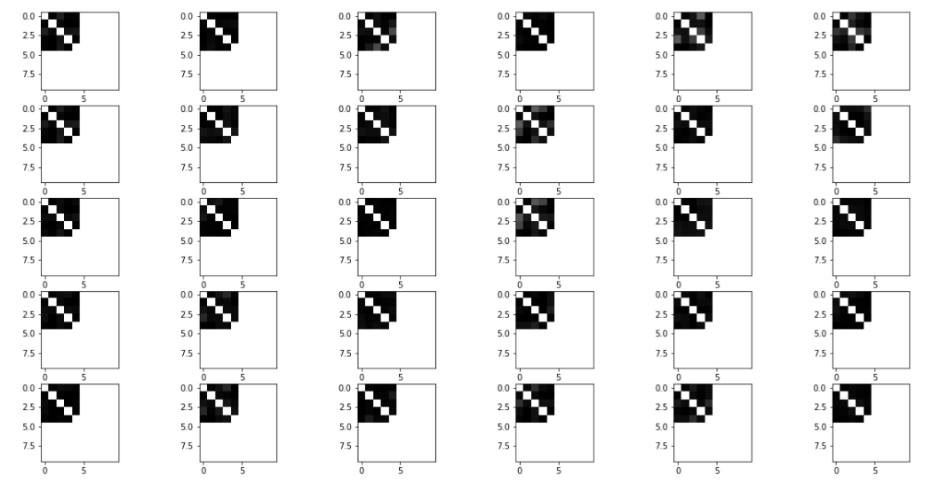
Generated adjacency matrices (filter_value=0.5)
Generated adjacency matrices (filter_value=0.7)

Slide 26
Node index | 1 | 2 | 3 | 4 | 5 | 6 | 7 | 8 | 9 | 10
Generated matrices centrality(filter_value=0.5) | 0.37 | 0.34 | 0.36 | 0.37 | 0.37 | 0.06 | 0.02 | 0.05 | 0.03 | 0.05
Original matrices centrality | 0.32 | 0.34 | 0.30 | 0.32 | 0.31 | 0. | 0. | 0. | 0. | 0.
Node index | 1 | 2 | 3 | 4 | 5 | 6 | 7 | 8 | 9 | 10
Generated matrices centrality(filter_value=0.7) | 0.38 | 0.38 | 0.37 | 0.38 | 0.38 | 0 | 0 | 0 | 0 | 0
Generated matrices centrality(filter_value=0.5) | 0.38 | 0.38 | 0.37 | 0.38 | 0.38 | 0.25 | 0.25 | 0.25 | 0.25 | 0.25
Original matrices centrality | 0.32 | 0.34 | 0.30 | 0.32 | 0.31 | 0. | 0. | 0. | 0. | 0.

Slide 27
p=0.25 simulation
Input: 30 graphs with 10 nodes
Optimizers: Adams optimizer with learning rate 0.001
Epoches: 1000000 epoches
Latent space: 2 out-channels
p = 0.25 for the upper left submatrix

Slide 28
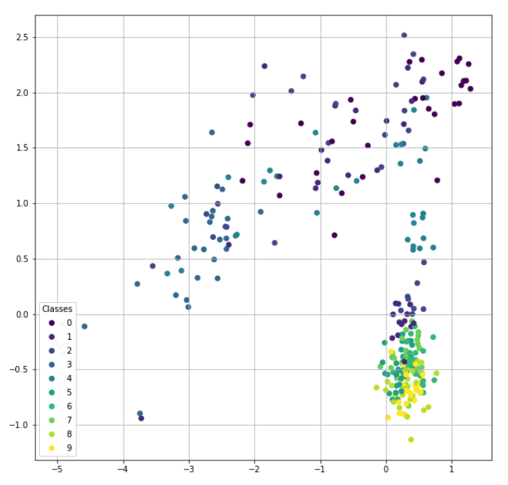

Slide 30
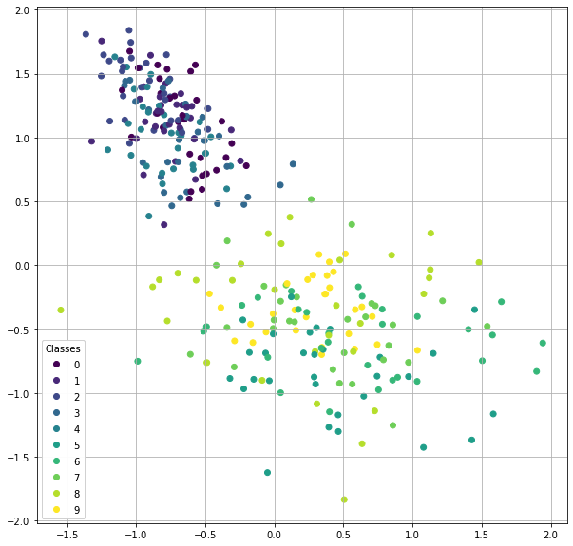
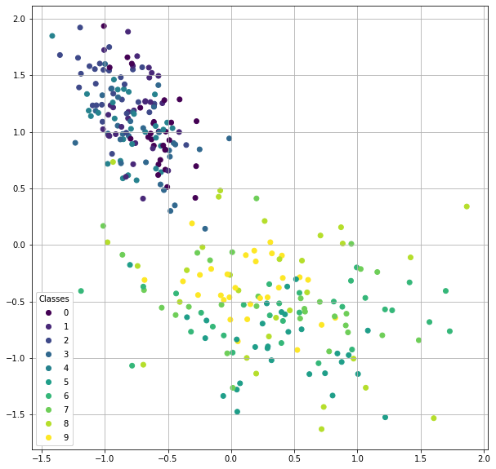
input
generated

Slide 31
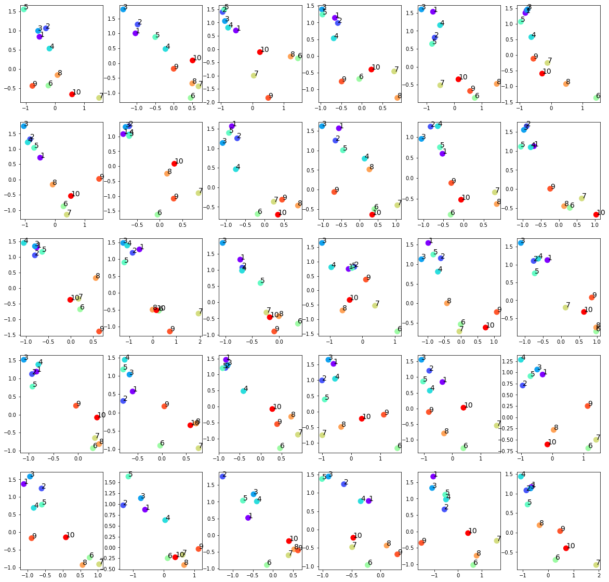

Slide 32
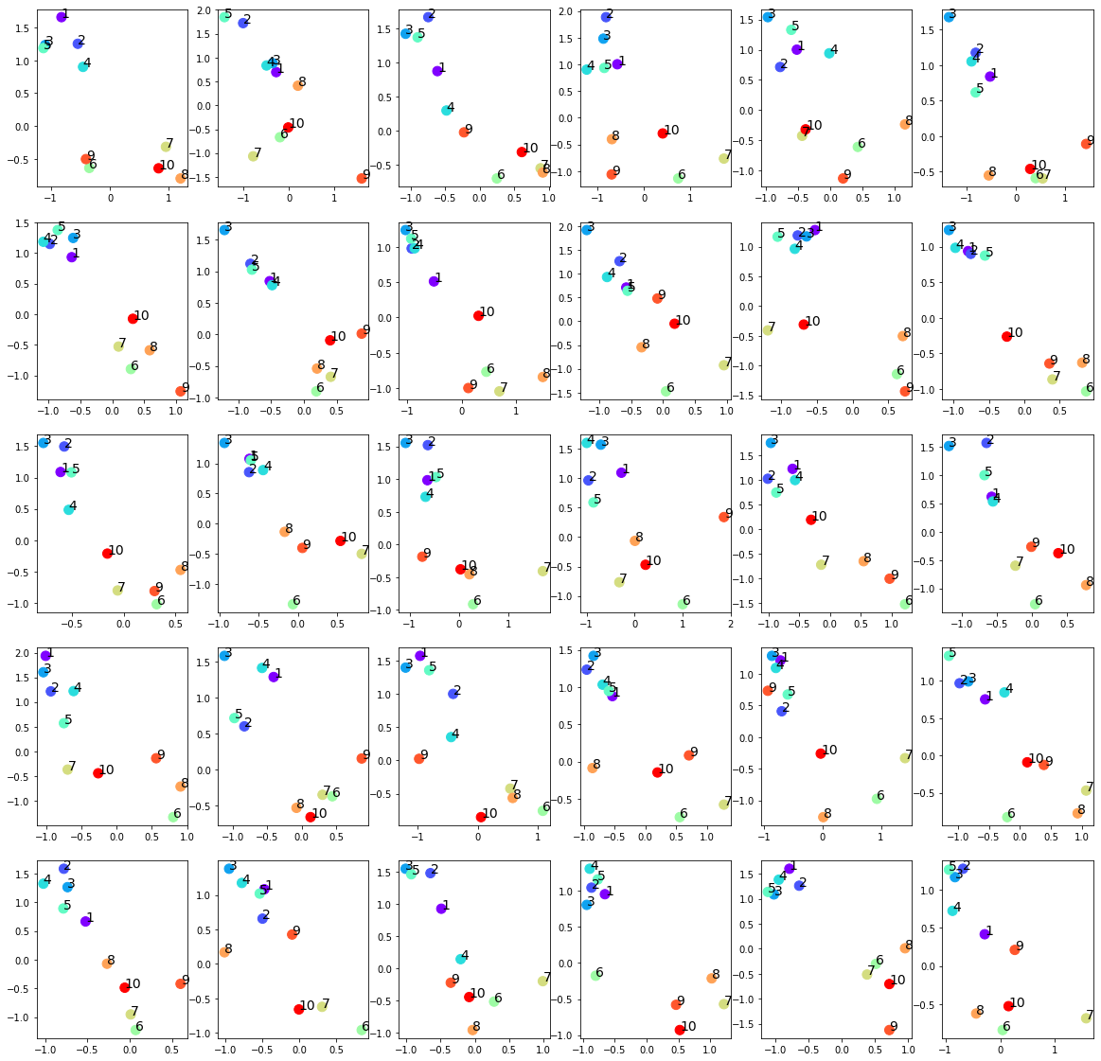

Slide 33
input
generated

Slide 34
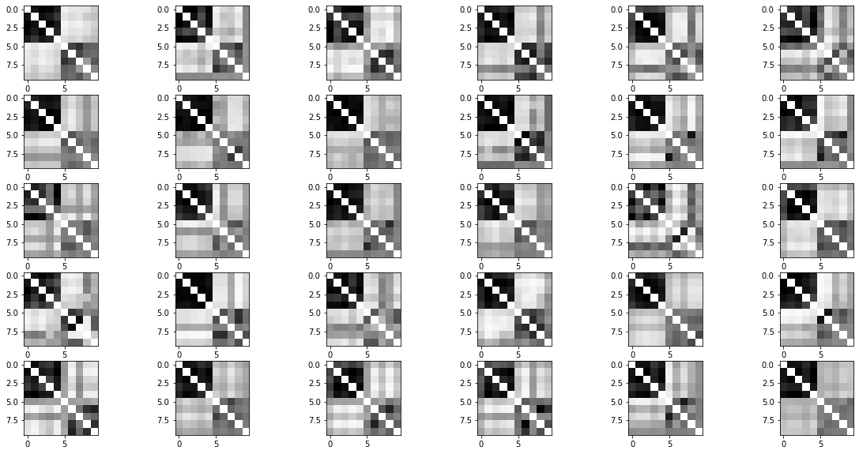
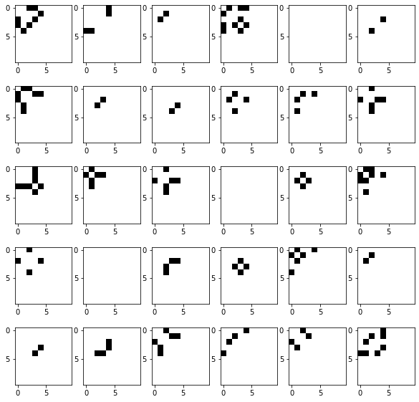
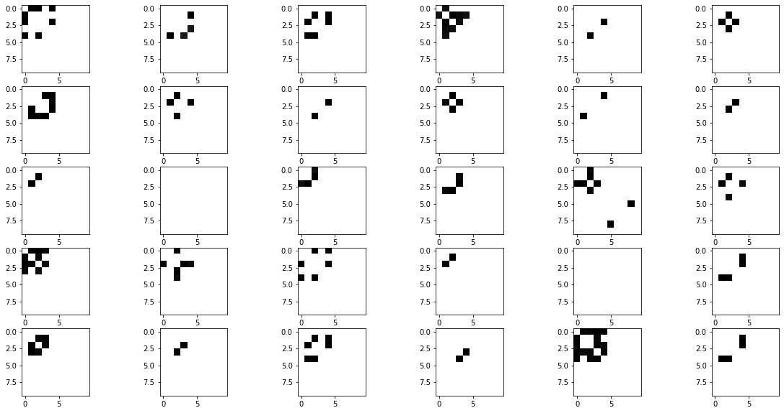
Raw generated adjacency matrices (filter_value=0)
Input adjacency matrices (p=0.25)
Generated adjacency matrices (filter_value=0.7)

Slide 35
Normalized Centrality
Node index | 1 | 2 | 3 | 4 | 5 | 6 | 7 | 8 | 9 | 10
Generated matrices centrality | 0.13 | 0.13 | 0.17 | 0.12 | 0.13 | 0.003 | 0.00 | 0.004 | 0.00 | 0.00
Original matrices centrality | 0.12 | 0.13 | 0.09 | 0.10 | 0.10 | 0.0 | 0.0 | 0.0 | 0.0 | 0.0

Slide 36
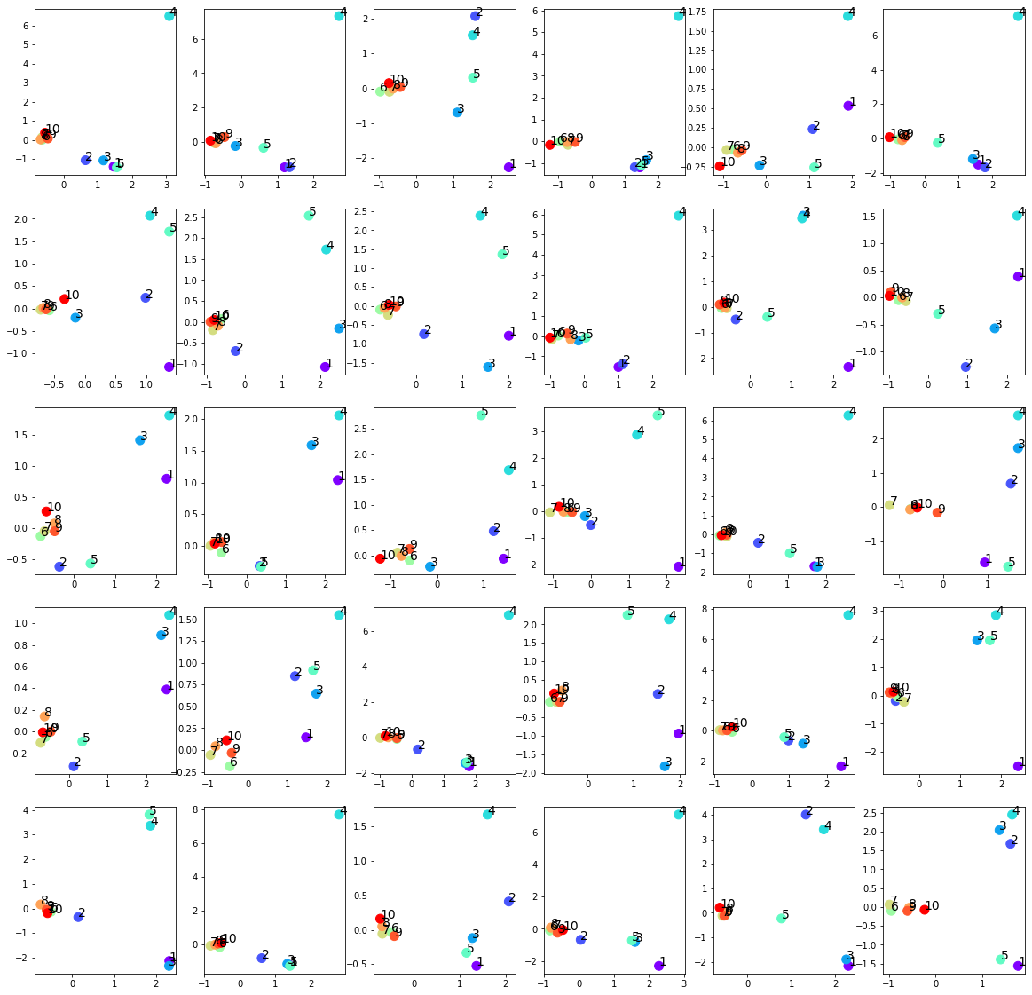
Failed trainings
Settings:
Input: 30 graphs with 10 nodes
Optimizers: Adams optimizer with learning rate 0.01
Epoches: 1000000 epoches
Latent space: 2 out-channels
p = 0.25 for the upper left submatrix
The last five nodes over-concentrate around 0
No effect on the first five nodes
Easier to happen when setting p<0.5

Slide 37
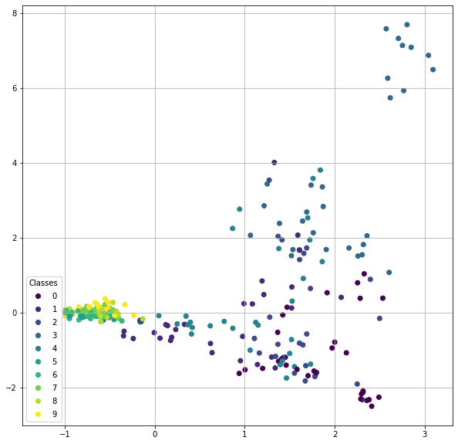
Another pattern
Settings:
Input: 30 graphs with 10 nodes
Optimizers: Adams optimizer with learning rate 0.01
Epoches: 1000000 epoches
Latent space: 2 out-channels
p = 0.25 for the upper left submatrix

Slide 38
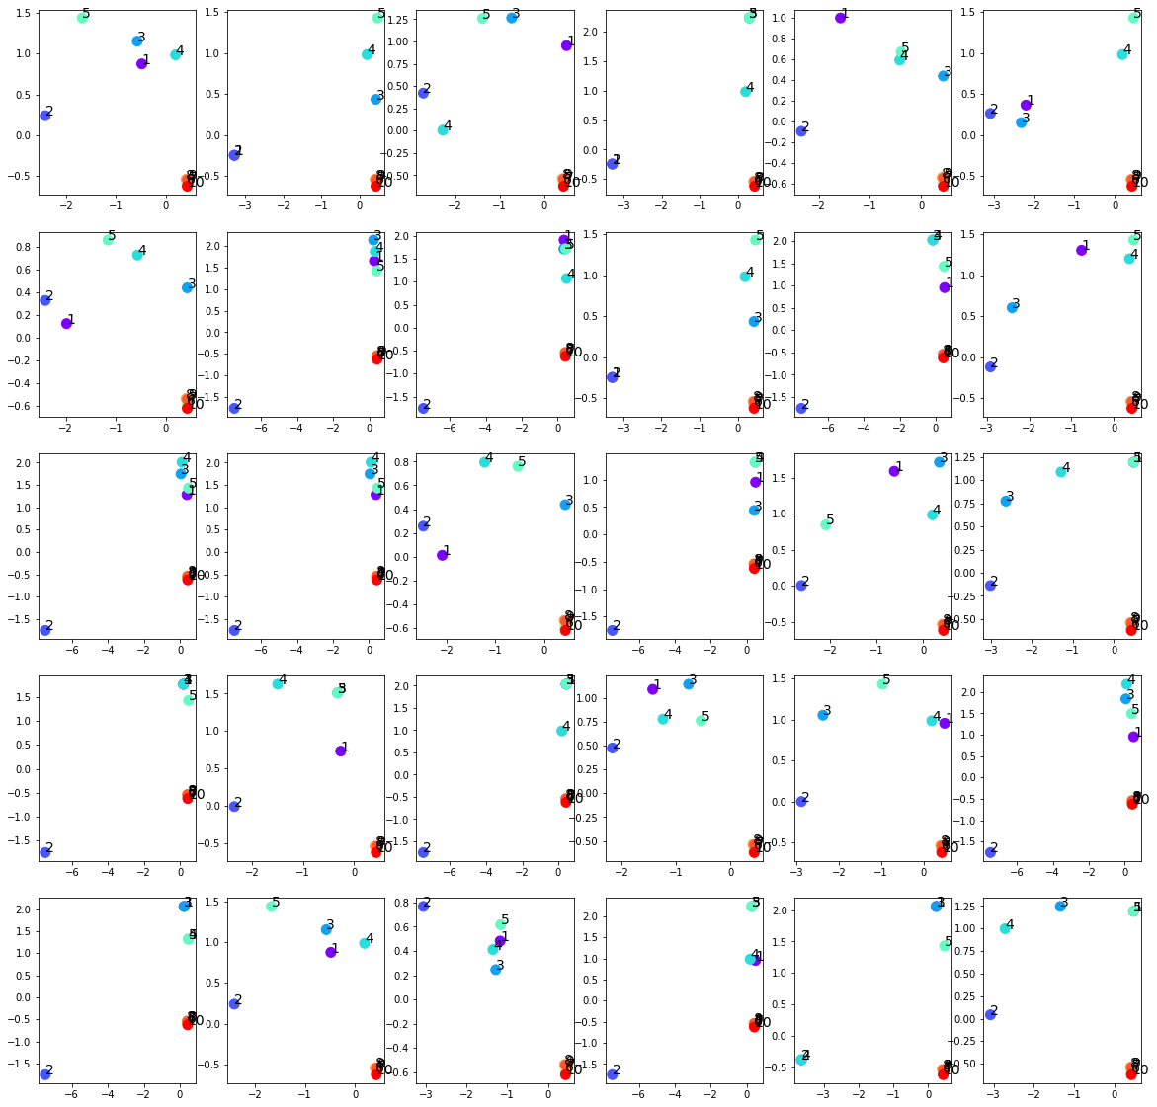

Slide 39
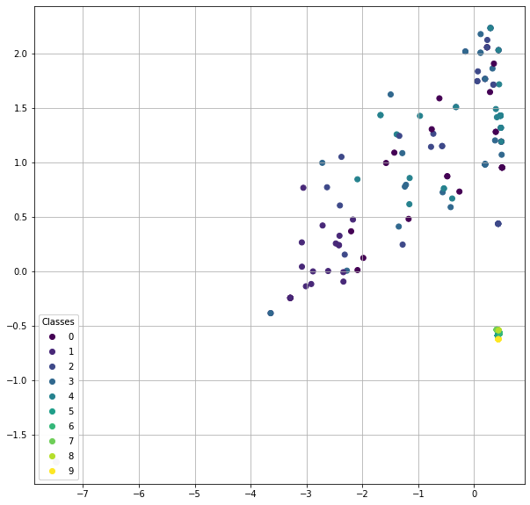

Slide 40
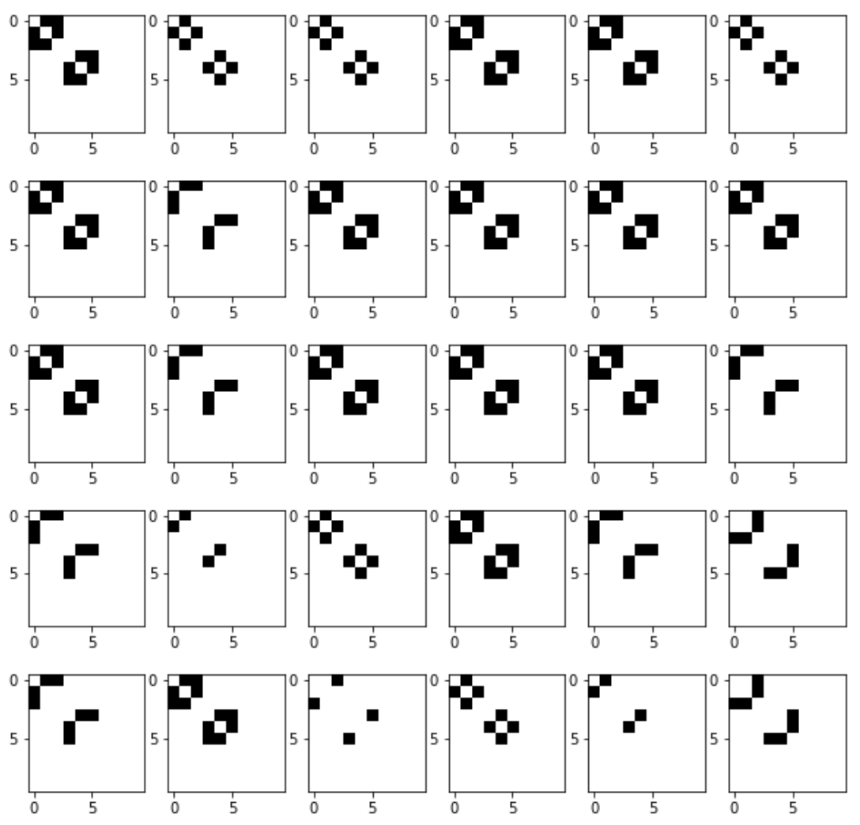

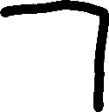
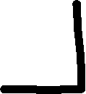

Slide 41
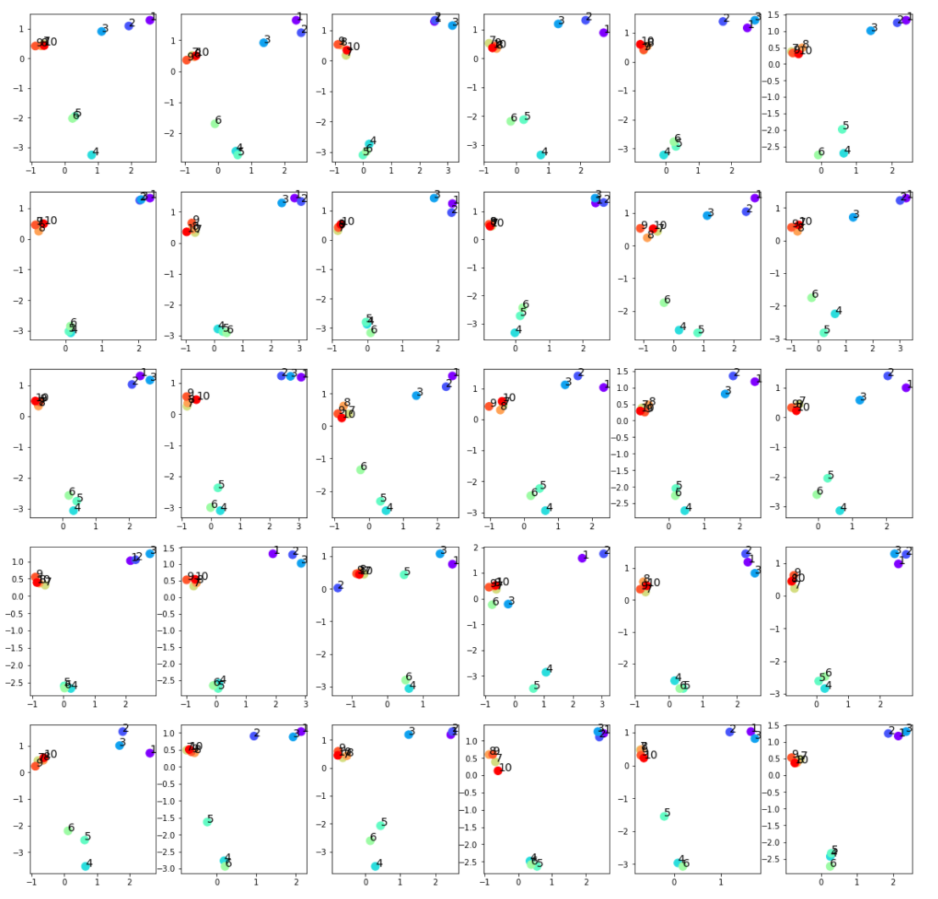
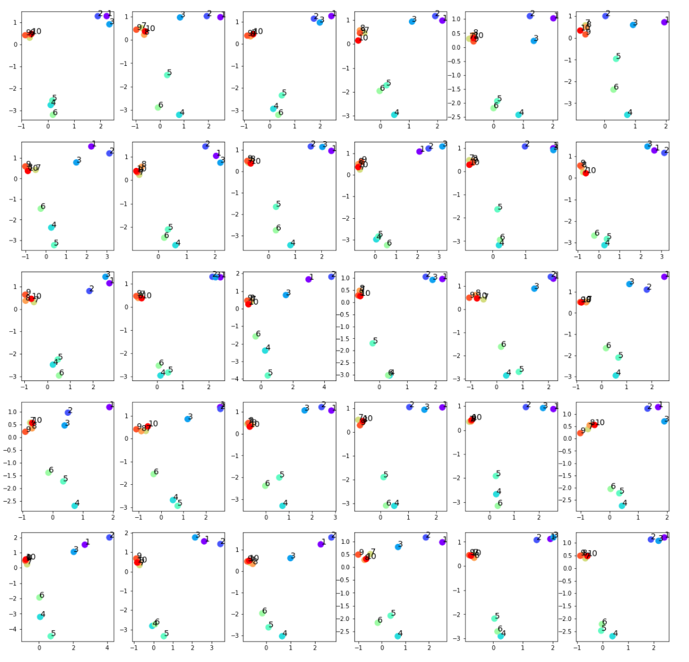
input
generated

Slide 42
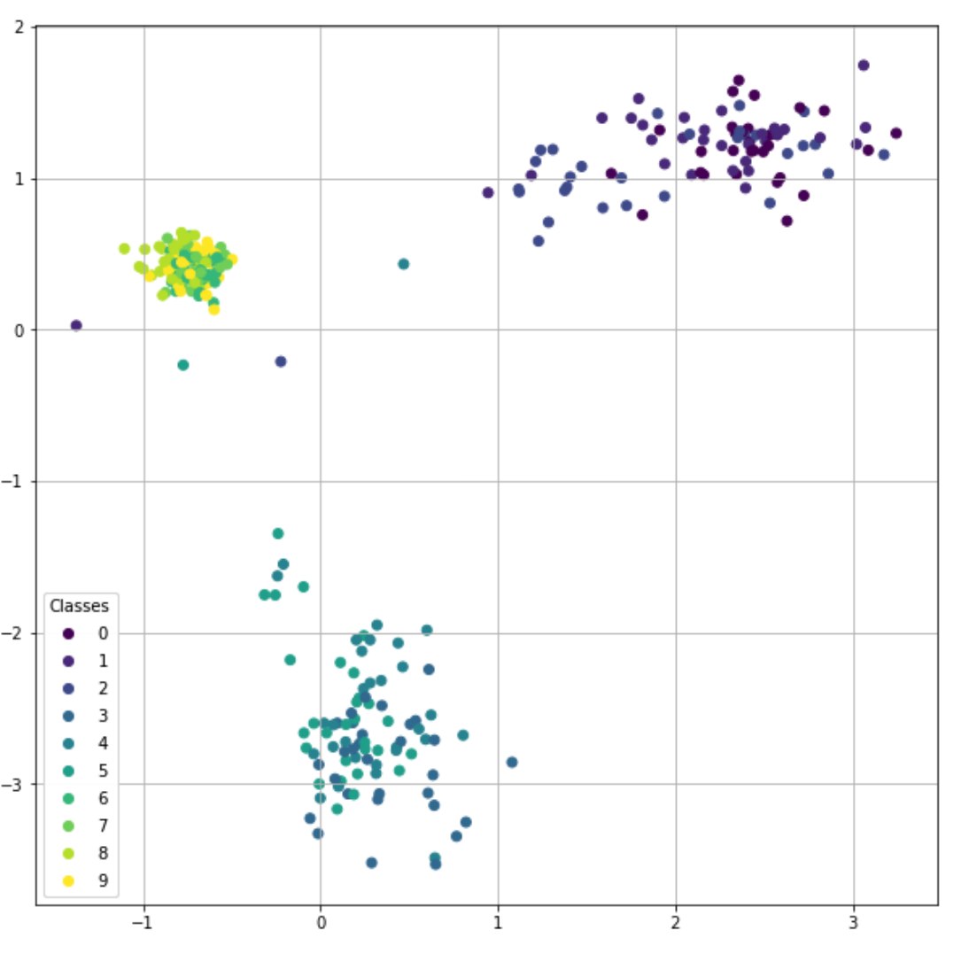
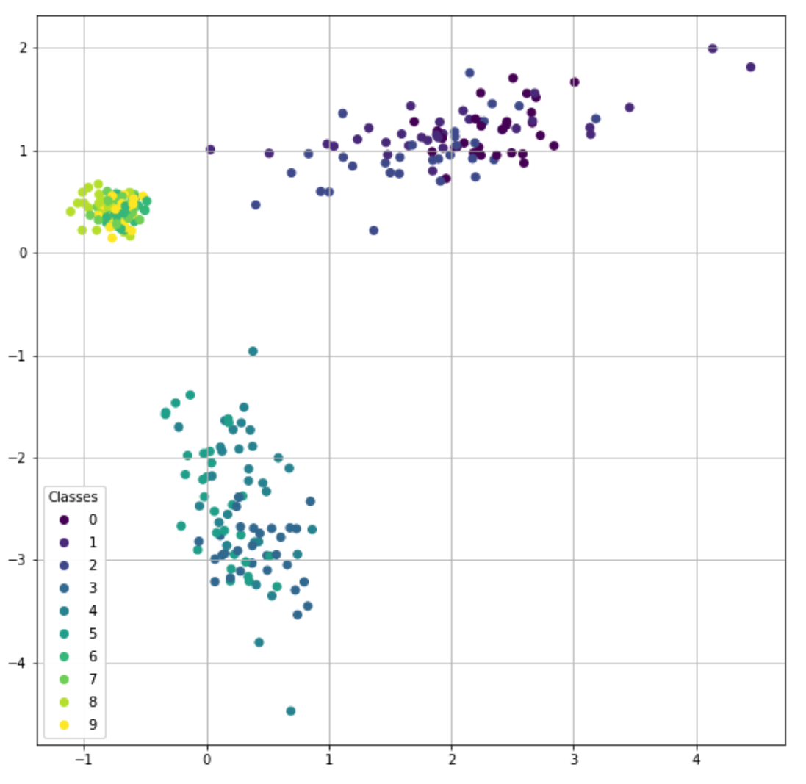
input
generated

Slide 43
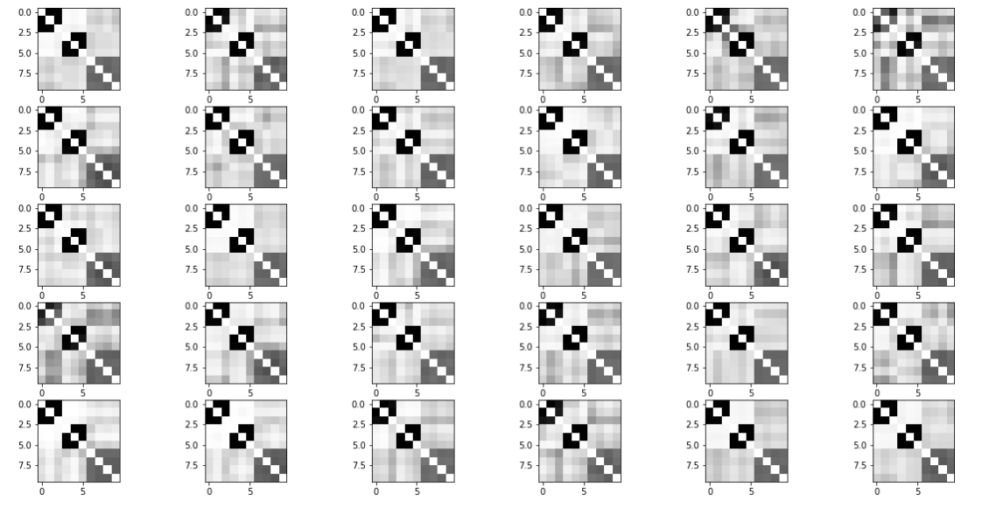
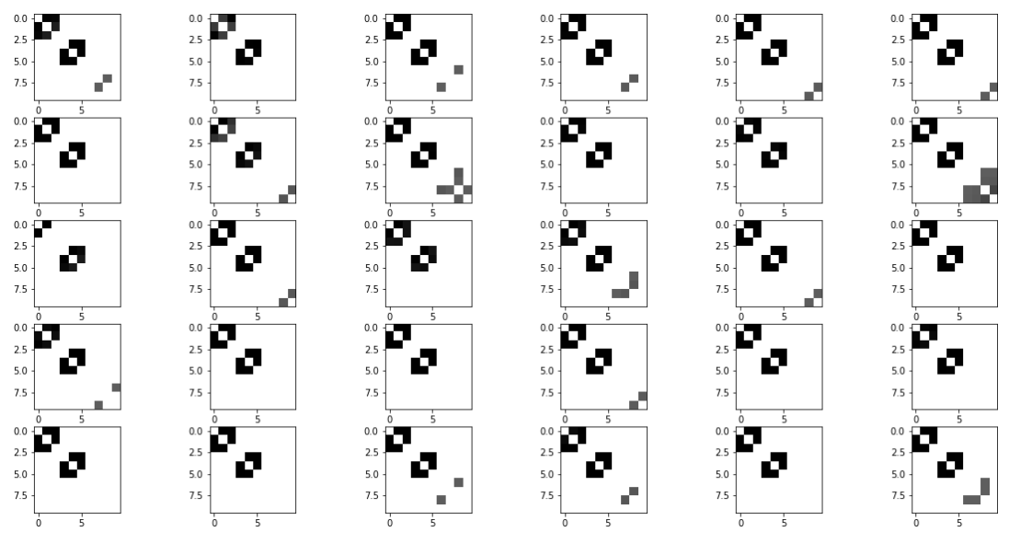
Raw generated adjacency matrices (filter_value=0)
Input adjacency matrices
Generated adjacency matrices (filter_value=0.5)

Slide 44
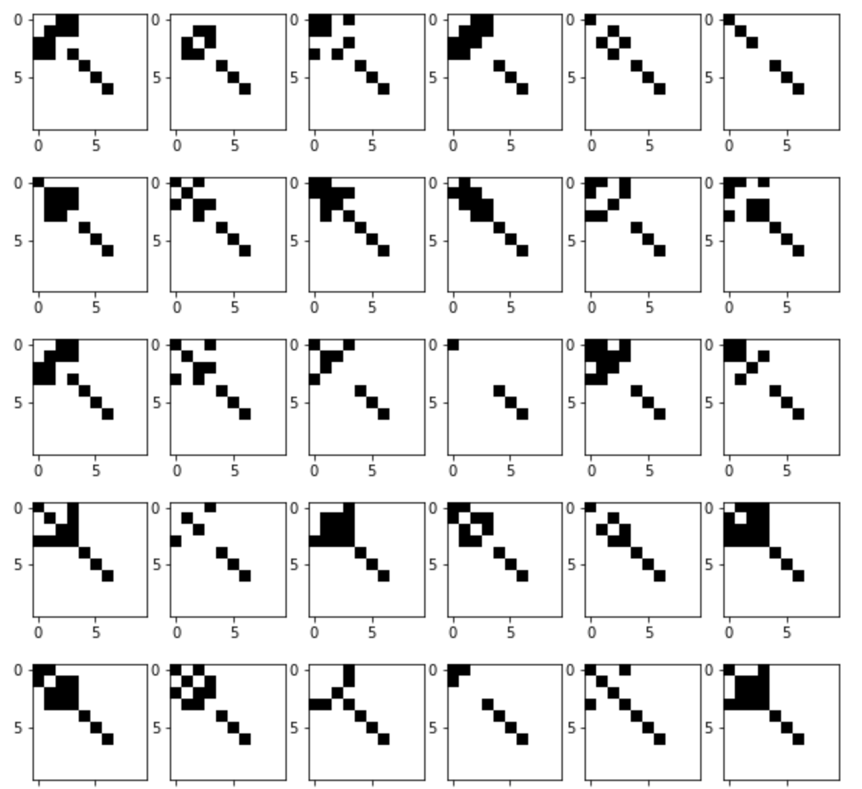
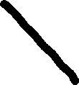
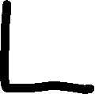
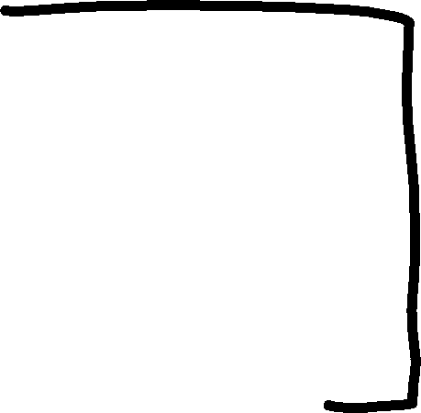






Slide 45


input
generated

Slide 46


input
generated

Slide 47


Raw generated adjacency matrices (filter_value=0)
Input adjacency matrices
Generated adjacency matrices (filter_value=0.5)

Slide 48




Slide 49


input
generated

Slide 50


input
generated

Slide 51


Raw generated adjacency matrices (filter_value=0)
Input adjacency matrices
Generated adjacency matrices (filter_value=0.5)

Slide 52

New sampling strategy
Fit $N$ (node number) Gaussian distribution $𝒩_{i}$ from each of $N$ rows of $\left\{μ_{i}\right\}.$
Sample $N z_{i}$ from the $N$Gaussian distribution $𝒩_{i}$.
Concatenate the $N z_{i}$ by row to get $z_{sample}$.

Slide 53




Sampled $μ$ for each nodes generated by the old sampling algorithm.
Sampled $μ$ for each nodes generated by the new sampling algorithm.

Slide 54




Sampled $μ$ for each nodes generated by the old sampling algorithm.
Sampled $μ$ for each nodes generated by the new sampling algorithm.

Slide 55


The generated adjacency matrices by the old sampling algorithm.
The generated adjacency matrices by the new sampling algorithm.

Slide 56

VGAE model for ipfdata
Input: 30 graphs with 38 nodes
Optimizers: Adams optimizer with learning rate 0.001
Epoches: 100000 epoches
Latent space: 2 out-channels

Slide 57



$μ$ of each node in the input data

Slide 58



$z$ of each node in the generated data

Slide 59


Generated adjancency matrices
Input adjancency matrices
Generated adjancency matrices (filter_value = 0.5)

Slide 60
Mean centrality in input adjacency matrices
array([0.6 , 0.7 , 0.4 , 0.74, 0.51, 0.74, 0.8 , 0.86, 0.8 , 0.74, 0.28, 0.76, 0.35, 0.77, 0.7 , 0.51, 0.76, 0.83, 0.83, 0.63, 0.38, 0.49, 0.36, 0.83, 0.41, 0.71, 0.45, 0.64, 0.48, 0.46, 0.47, 0.39, 0.44, 0.7 , 0.56, 0.8 , 0.3 , 0.1 ])
Mean centrality in generated adjacency matrices
array([0.65, 0.67, 0.59, 0.67, 0.61, 0.67, 0.69, 0.7 , 0.68, 0.67, 0.47, 0.69, 0.51, 0.68, 0.62, 0.54, 0.68, 0.7 , 0.7 , 0.6 , 0.56, 0.59, 0.52, 0.7 , 0.52, 0.62, 0.58, 0.6 , 0.62, 0.57, 0.59, 0.54, 0.55, 0.66, 0.58, 0.67, 0.47, 0.32])
mean centrality in input - mean centrality in generated
array([-0.06, 0.04, -0.19, 0.06, -0.1 , 0.07, 0.12, 0.16, 0.11, 0.06, -0.19, 0.07, -0.15, 0.1 , 0.09, -0.03, 0.08, 0.13, 0.12, 0.03, -0.18, -0.1 , -0.16, 0.13, -0.11, 0.09, -0.13, 0.04, -0.14, -0.11, -0.12, -0.15, -0.11, 0.04, -0.02, 0.13, -0.17, -0.21])

Slide 61

VGAE model for ctrldata
Input: 28 graphs with 38 nodes
Optimizers: Adams optimizer with learning rate 0.001
Epoches: 100000 epoches
Latent space: 2 out-channels

Slide 62


$μ$ of each node in the input data

Slide 63



$μ$ of each node in the generated data

Slide 64


Generated adjancency matrices
Input adjancency matrices
Generated adjancency matrices (filter_value = 0.5)

Slide 65
Mean centrality in input adjacency matrices
array([0.5 , 0.5 , 0.27, 0.55, 0.34, 0.55, 0.6 , 0.44, 0.49, 0.49, 0.2 , 0.5 , 0.24, 0.61, 0.62, 0.34, 0.49, 0.62, 0.52, 0.41, 0.29, 0.3 , 0.19, 0.42, 0.25, 0.24, 0.26, 0.28, 0.25, 0.16, 0.27, 0.06, 0.25, 0.23, 0.16, 0. , 0.06, 0.17])
Mean centrality in generated adjacency matrices
array([0.55, 0.56, 0.46, 0.58, 0.5 , 0.58, 0.59, 0.48, 0.54, 0.55, 0.3 , 0.51, 0.39, 0.58, 0.58, 0.41, 0.45, 0.59, 0.52, 0.48, 0.44, 0.47, 0.37, 0.46, 0.4 , 0.34, 0.44, 0.4 , 0.43, 0.32, 0.42, 0.22, 0.38, 0.35, 0.31, 0.2 , 0.23, 0.29])
mean centrality in input - mean centrality in generated
array([-0.05, -0.06, -0.2 , -0.03, -0.15, -0.04, 0.01, -0.04, -0.05, -0.06, -0.1 , -0.01, -0.15, 0.03, 0.05, -0.07, 0.04, 0.03, 0. , -0.07, -0.15, -0.17, -0.18, -0.04, -0.15, -0.1 , -0.17, -0.12, -0.18, -0.16, -0.15, -0.16, -0.13, -0.12, -0.15, -0.2 , -0.17, -0.12])

Slide 66
VGAE model for mixed data
Input: 60 IPF and control graphs
Optimizers: Adams optimizer with learning rate 0.001
Epoches: 100000 epoches
Latent space: 2 out-channels

Slide 67

VGAE model for mixed data
Question:
How do we distinguish embedded mu patterns of ipf_data from mu patterns of ctrl_data?
What value should we set for the out-channels for increasing number of nodes?

